Slide 1


Slide 2
BRAINIACS OLYMPIAD 2026
CODING SAMPLE CHALLENGES
(GRADES 3–4)
Easy challenges – 40
Medium challenges – 40
Hard challenges – 20

Slide 3
Easy challenges – 40

Slide 4
Easy challenges
1. Create a program where a sprite walks from left to right across the stage.
When the sprite touches the edge of the stage, it should turn around and walk the other way.
While walking, the sprite’s legs should move (leg animation).

Slide 5
Easy challenges
2. Create a program where the sprite plays different animal sounds when specific keys are pressed:
Key C → play “meow”
Key D → play “bark”
Key R → play “cock-a-doodle-doo”
Key P → play “oink”
Key H → play “neigh”
Key W → play “howl”

Slide 6
Easy challenges
3. Create a program where the sprite plays different sounds and transforms into animals when specific keys are pressed:
Key C → play “meow” – transforms into a cat
Key D → play “bark” – transforms into a dog
Key R → play “cock-a-doodle-doo” – transforms into a rooster
Key P → play “oink” – transforms into a pig
Key H → play “neigh” – transforms into a horse
Key W → play “howl” – transforms into a wolf

Slide 7
Easy challenges
4. Write a program where the sprite follows the mouse pointer. While walking, the sprite’s legs should move (leg animation).

Slide 8
Easy challenges
5. Write a program where the sprite is controlled using arrow keys. While walking, the sprite’s legs should move (leg animation).

Slide 9
Easy challenges
6. Draw a traffic light sprite and create an animation showing how the traffic light works.

Slide 10
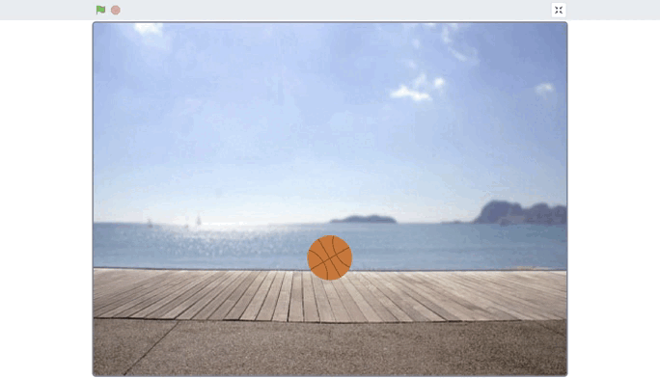
Easy challenges
7. Create an animation of a falling ball as shown in the picture below.

Slide 11
Easy challenges
8. Exploding Sprite
When the green flag is clicked, the sprite appears in the center of the stage at its original size.
When the sprite is clicked, it gradually shrinks, a boom sound plays, and then the sprite disappears.
On the next program run, the sprite reappears in the center and returns to its original size.

Slide 12
Easy challenges
9. Balloon Sprite
Add a sprite called “Balloon”.
When the green flag is clicked, the balloon shows in a random location for 2 seconds, then hides and shows in another random location.
If the balloon is clicked, it pops: a “pop” sound plays, it hides, then shows in a new location with a new color.
The balloon’s color changes only when it is popped.

Slide 13
Easy challenges
10. Slow Steps
The sprite asks for a number N, then moves N steps very slowly.

Slide 14
Easy challenges
11. Growing Balloon
Add a sprite “Balloon”.
When the green flag is clicked, the balloon asks the user for a number between 150 and 300.
The balloon grows smoothly to the specified size, then pops, returns to its original size, and asks the question again.

Slide 15
Easy challenges
12. Draw a Square
The sprite asks the user for a number N and then draws a square with sides of length N.

Slide 16
Easy challenges
13. Write a program to control the sprite using the arrow keys. When the space key is pressed, the cat says its x and y position for two seconds.

Slide 17
Easy challenges
14. When the sprite is clicked, it runs away from the cursor to a random position.

Slide 18
Easy challenges
15. When the “1” key is pressed, the sprite moves forward continuously; when “2” is pressed, it moves backward; and only when “3” is pressed - the sprite stops.

Slide 19
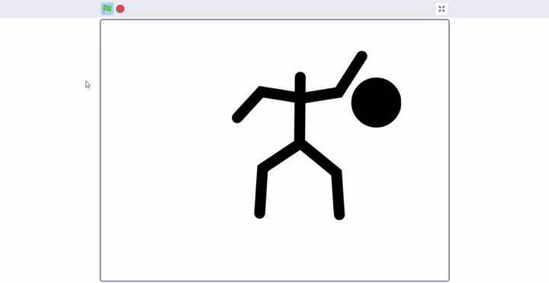
Easy challenges
16. Create a dancing animation for the sprite.
Example:

Slide 20
Easy challenges
17. Add the “Heart” sprite. Create an animation in which the heart pulses while a heartbeat sound plays simultaneously.

Slide 21
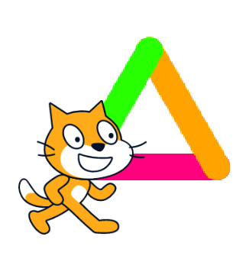
Easy challenges
18. Write a program in which the sprite draws a triangle, changing the pen color on each side.

Slide 22
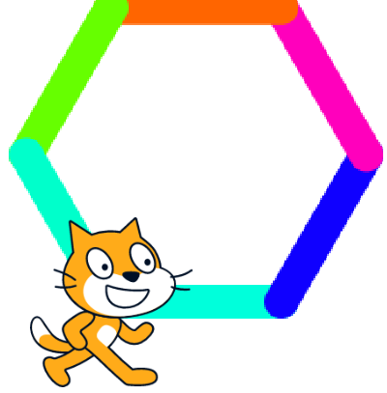
Easy challenges
19. Write a program in which the sprite draws a hexagon, changing the pen color on each side.

Slide 23
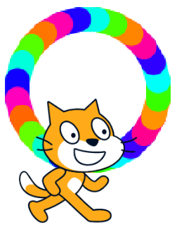
Easy challenges
20. Write a program in which the sprite draws a multicolored circle.

Slide 24
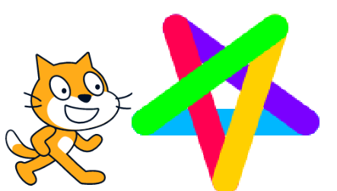
Easy challenges
21. Write a program in which the sprite draws a star, changing the pen color on each side.

Slide 25
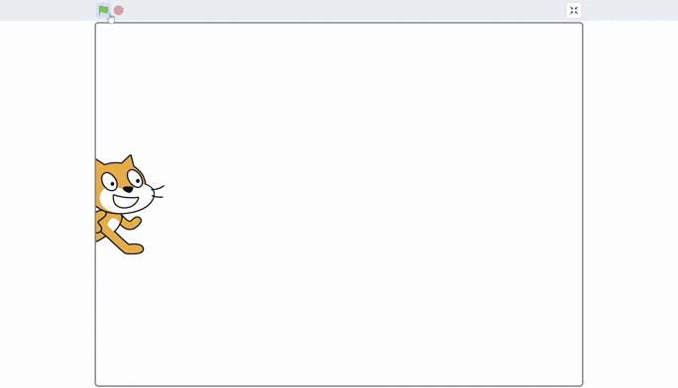
Easy challenges
22. Write a program in which the cat draws a straight line 400 steps long, with a smooth thickening effect. An example of how the line should look:

Slide 26

Easy challenges
23. Write a program in which the sprite draws a circle with a smoothly thickening line.

Slide 27
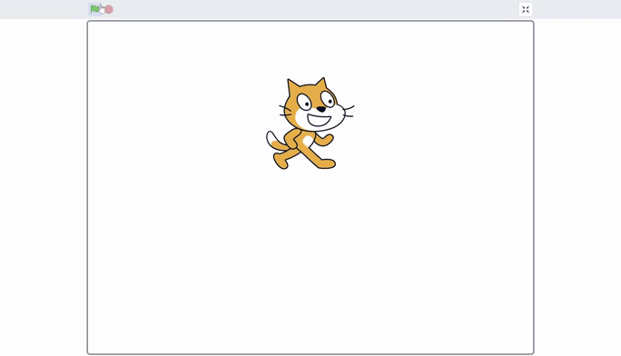
Easy challenges
24. Write a program in which the sprite draws a circle with a smoothly thickening line and changing colors.

Slide 28
Easy challenges
25. Create a program where pressing the Up arrow increases the sprite’s size by 5%, pressing the Down arrow decreases its size by 5%, and pressing the space bar returns its size to 100%.

Slide 29
Easy challenges
26. Write a program to control the sprite with the arrow keys. If the sprite touches the black walls on the stage, it cannot pass through them and must stop in front of the obstacle.

Slide 30
Easy challenges
27. Create a traffic light animation: the red light stays on for 5 seconds, then blinks 3 times; then the yellow light turns on for 3 seconds; after that, the green light turns on for 5 seconds and then blinks 3 times; the cycle ends with the yellow light again, which stays on for 3 seconds.

Slide 31
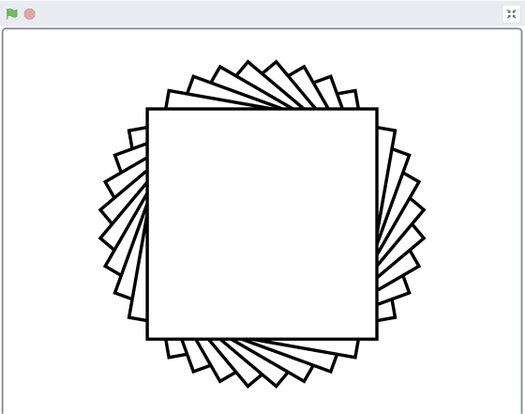
Easy challenges
28. Write a program for the “White Square” sprite that, after clicking the green flag, draws a specified pattern on the stage using the pen. Example of the drawing:

Slide 32
Easy challenges
29. Create a firework animation using multicolored clones.

Slide 33
Easy challenges
30. Create a “Cat and Mouse” game: there are two sprites on the stage — the Cat and the Mouse. The Cat is controlled with the arrow keys and can move in all directions. The Mouse follows the mouse pointer, constantly changing direction. If the Cat touches the Mouse, the game ends immediately and the Cat wins.

Slide 34
Easy challenges
31. Create an animation of clouds moving across the stage; when the clouds reach the edge of the stage, they appear again on the opposite side.

Slide 35
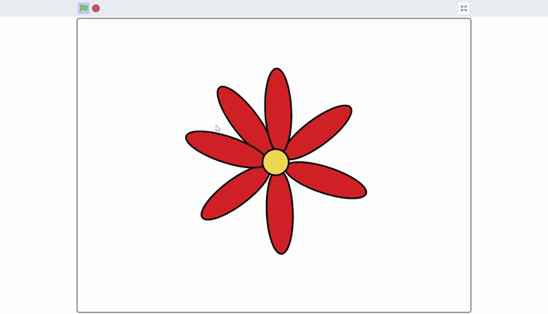
Easy challenges
32. Draw a “Flower” sprite. When the right arrow key (→) is pressed, the flower rotates clockwise; when the left arrow key (←) is pressed, the flower rotates counterclockwise.

Slide 36
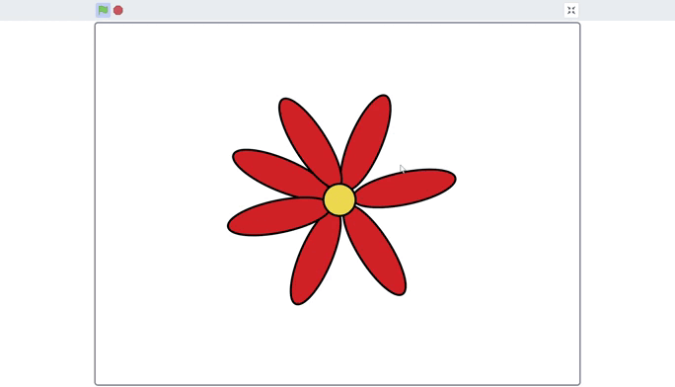
Easy challenges
33. Draw a “Flower” sprite. When the → (right arrow) key is pressed, the flower rotates continuously clockwise; when the ← (left arrow) key is pressed, it rotates continuously counterclockwise; pressing the space key stops the rotation.

Slide 37
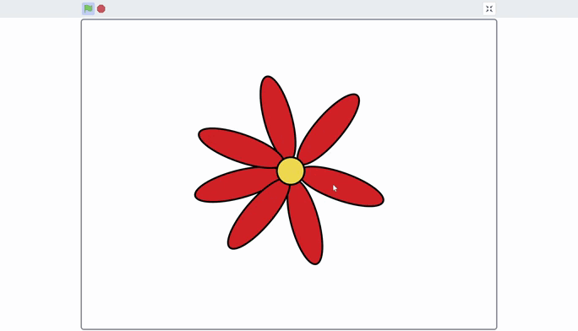
Easy challenges
34. Draw a “Flower” sprite. When the sprite is clicked with the mouse pointer, it begins rotating around its axis.

Slide 38
Easy challenges
35. Draw a “Flower” sprite. When the sprite is clicked with the mouse pointer, it begins rotating around its axis. Pressing the space key stops the rotation. After stopping, clicking the sprite again makes the flower rotate again.

Slide 39
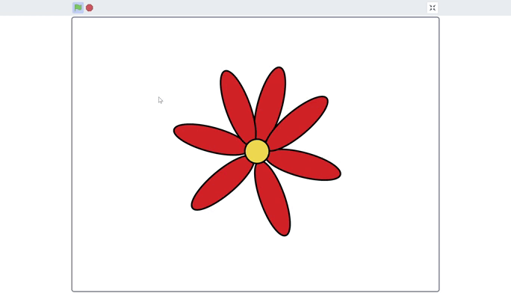
Easy challenges
36. Draw a “Flower” sprite. When the sprite is clicked with the mouse pointer, it starts rotating slowly around its axis; each subsequent click increases the rotation speed (the more clicks, the faster it spins). Pressing the space key stops the rotation.

Slide 40
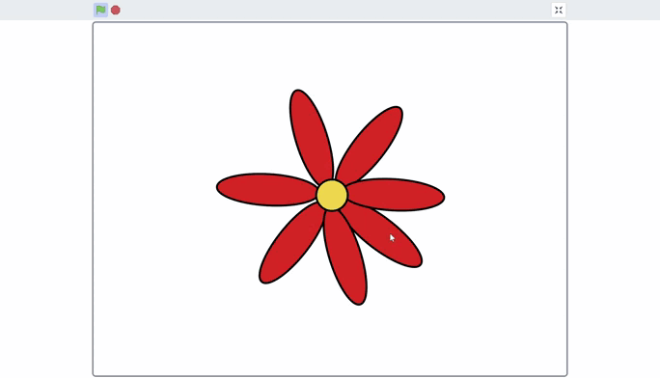
Easy challenges
37. Draw a “Flower” sprite. When the sprite is clicked with the mouse pointer, it starts rotating slowly around its axis; each subsequent click increases the rotation speed (the more clicks, the faster it spins). After starting, the rotation gradually slows down over time and eventually stops completely.

Slide 41
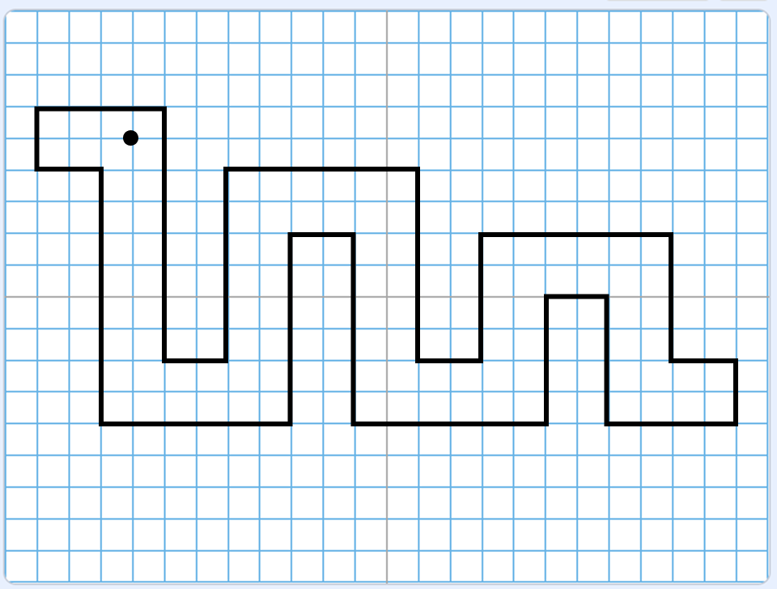
Easy challenges
38. Pixel drawing. Create a program in which the sprite moves along a pre-defined path and draws a “pixel-style” picture.

Slide 42
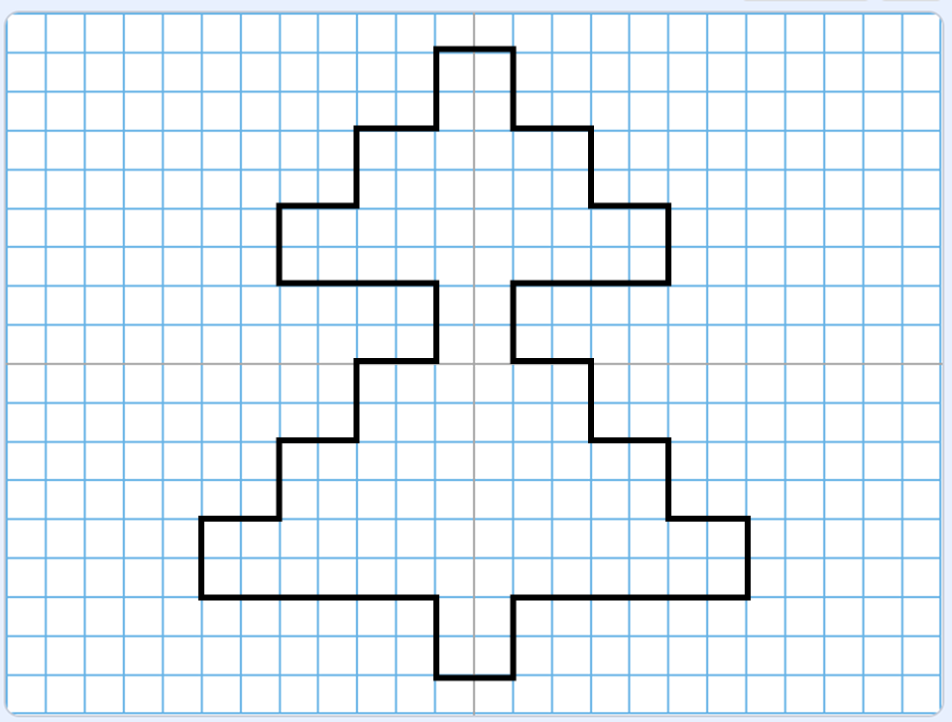
Easy challenges
39. Pixel drawing. Create a program in which the sprite moves along a pre-defined path and draws a “pixel-style” picture.

Slide 43
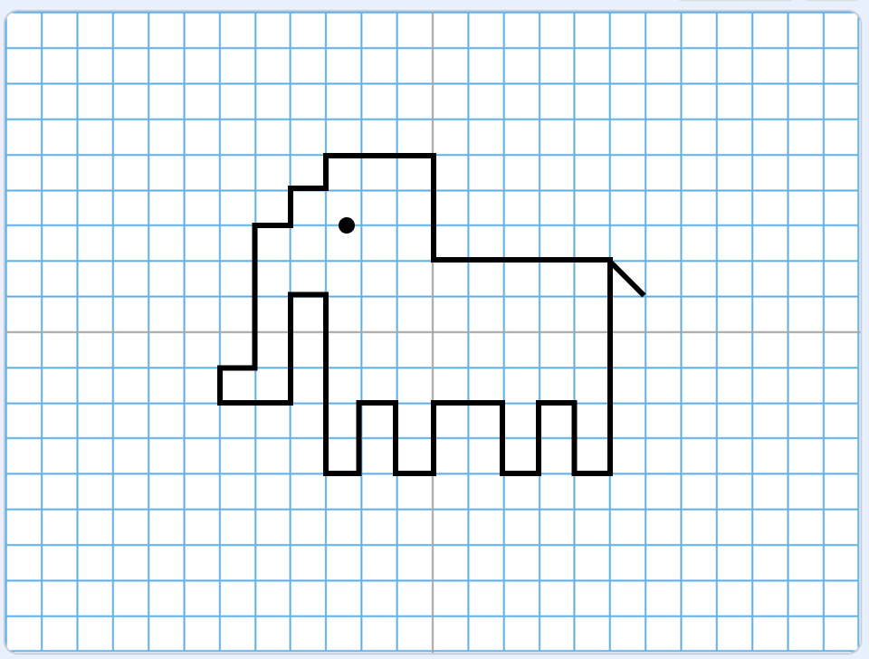
Easy challenges
40. Pixel drawing. Create a program in which the sprite moves along a pre-defined path and draws a “pixel-style” picture.

Slide 44
Medium challenges – 40

Slide 45
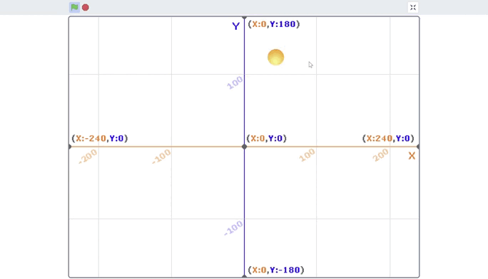
Medium challenges
1. Looking at the given GIF animation, write a program in which the “Ball” sprite moves across the stage exactly like in the example and changes its color depending on which area of the stage it is in.

Slide 46
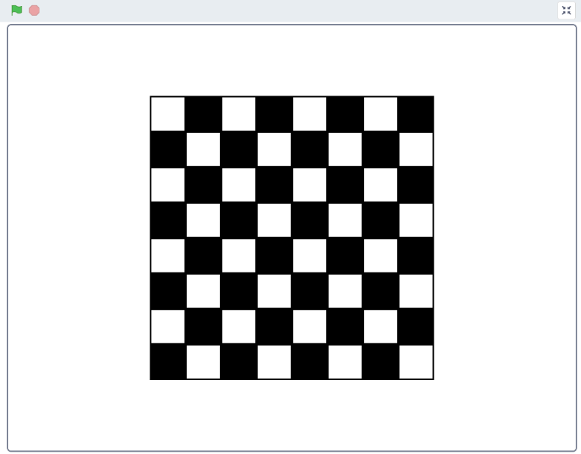
Medium challenges
2. Using a single “Square” sprite, write a program that, after clicking the green flag, automatically creates an 8×8 chessboard.

Slide 47
Medium challenges
3. There are three sprites on the stage — white, gray, and black circles. After clicking the green flag, all three circles start moving horizontally, bouncing off the edges of the stage. Their speeds should be set so that while the white circle completes two full back-and-forth passes, the gray circle completes three, and the black circle completes four.

Slide 48
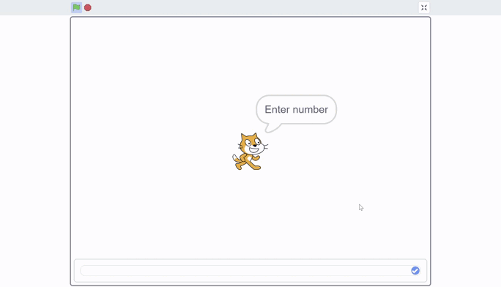
Medium challenges
4. The sprite asks for a number N, after which it draws N consecutive zigzags using the pen. Example:

Slide 49
Medium challenges
5. Write a program — the sprite asks for a number N, then says the sum of squares of that number. For example, if the entered number is 2, the sum of squares will be 8.

Slide 50
Medium challenges
6. Write a program — the sprite asks for a number N, then says all numbers from 1 to N. If the number is negative, the sprite asks for a new number.

Slide 51
Medium challenges
7. Write a program — the sprite asks for a number N, then says all odd numbers from 1 to N. If the number is negative, the sprite asks for a new number.

Slide 52
Medium challenges
8. Write a program — the sprite asks for a number N, then says all even numbers from 2 to N. If the number is negative, the sprite asks for a new number.

Slide 53
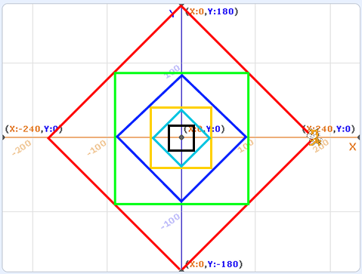
Medium challenges
9. Using pen blocks, draw the picture shown below.

Slide 54
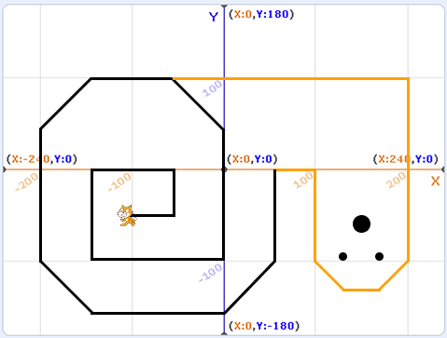
Medium challenges
10. Using pen blocks, draw the picture shown below.

Slide 55
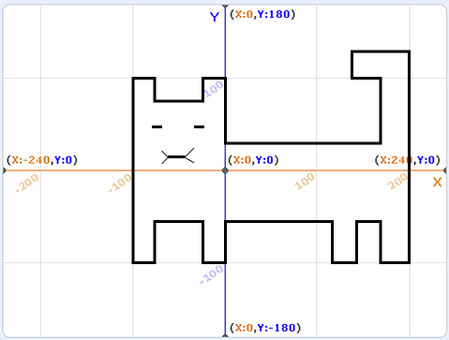
Medium challenges
11. Using pen blocks, draw the picture shown below.

Slide 56
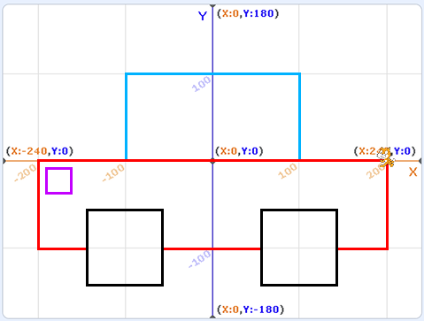
Medium challenges
12. Using pen blocks, draw the picture shown below.

Slide 57
Medium challenges
13. Hungry sprite. Over time, the sprite’s size decreases; if it is given food, it restores its size. When the food touches the sprite, it hides and shows in a new location, and the sprite makes a munching sound.

Slide 58
Medium challenges
14. Coin Collection. Create a “Coin Collection” game: 10 coins appear on the stage in random positions; the main sprite is controlled with the arrow keys. When the sprite touches a coin, the variable “Coins” increases by 1, and the coin disappears (or moves to a new random position). The program should continue working correctly until all coins are collected.

Slide 59
Medium challenges
15. Coins should appear randomly on the stage, each for a random duration and at a random location. The main sprite follows the mouse pointer and can collect the coins. When the sprite touches a coin, it disappears, and the variable “Coins” increases by 1. The game lasts twenty seconds, after which it ends and shows the player how many coins were collected.

Slide 60
Medium challenges
16. “Coin Collection” program. The user enters a number N, after which the sprite must collect N coins before the program ends.

Slide 61
Medium challenges
17. Create a single-player ping-pong game. The sprite moves along the x-axis by following the mouse pointer.

Slide 62
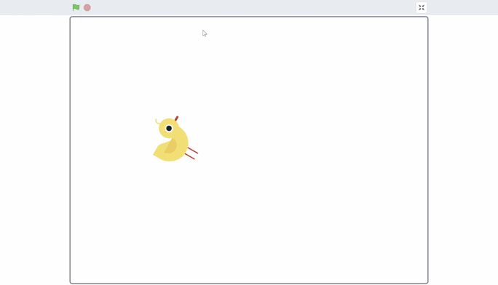
Medium challenges
18. The sprite moves along a pentagon path and leaves a mark at each vertex of the shape.

Slide 63
Medium challenges
19. The sprite asks for a number N, after which it moves along an N-sided polygon path, leaving a mark at each edge. Each side of the shape is 100 steps long.

Slide 64
Medium challenges
20. Create a “Cat and Mouse” game: there are two sprites on the stage — the Cat and the Mouse. The Cat is controlled with the arrow keys and can move in all directions. The Mouse follows the mouse pointer, constantly changing direction. If the Cat touches the Mouse, the game ends immediately and the Cat wins. If the Mouse successfully escapes and is not caught within 20 seconds, the Mouse wins.

Slide 65
Medium challenges
21. Write a program where the sprite’s size depends on the sound volume — the louder the sound, the bigger the sprite.

Slide 66
Medium challenges
22. Celsius to Fahrenheit Converter
The user enters a number.
The sprite calculates and displays the result using the formula: F = C × 1.8 + 32.
If the value is unusual (for example, below -100), the sprite shows a warning.

Slide 67
Medium challenges
23. The sprite asks for a number N, then says whether the number is positive or negative.

Slide 68
Medium challenges
24. The sprite asks for a number N, then says whether the number is even or odd.

Slide 69
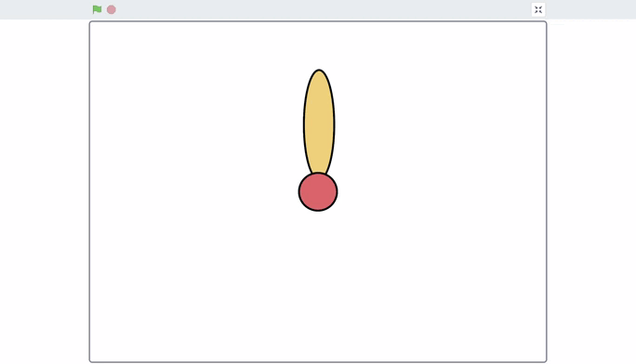
Medium challenges
25. Write a program in which the sprite repeats the given animation:

Slide 70
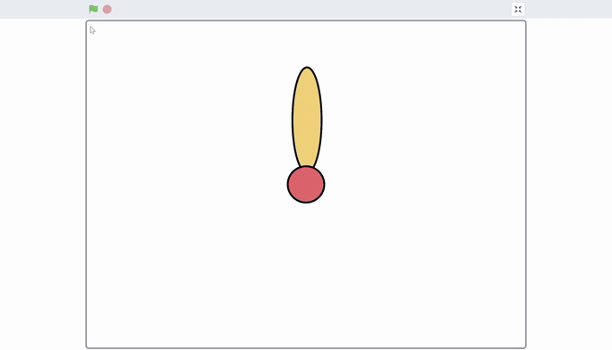
Medium challenges
26. Write a program in which the sprite asks for a number N and draws a flower with N petals.

Slide 71
Medium challenges
27. Write a program in which the sprite asks for a number N, then draws a square with side length N and displays the area of the square.

Slide 72
Medium challenges
28. Write a program in which the sprite asks for a number N, then draws a square with side length N and displays the perimeter of the square.

Slide 73
Medium challenges
29. “Space Quiz” program.
Create a quiz in which a cosmonaut sprite asks the player 5 questions about space. After each question, the user enters an answer.
- If the answer is correct, the cosmonaut says it is correct and moves to the next question.
- If the answer is incorrect, the cosmonaut asks the player to try again and repeats the question until the correct answer is given.
After successfully answering all 5 questions, the quiz ends with a congratulatory message.

Slide 74
Medium challenges
30. Unit Converter.
Write a program in which the sprite asks the user to enter a number N in centimeters. After input, the program converts this value to meters, and the sprite announces the result. For example, if the user enters 250, the sprite should say: “250 cm = 2.5 m.”

Slide 75
Medium challenges
31. Math Quiz.
The sprite displays two random numbers and asks the user to enter their sum. After the answer is entered, the sprite indicates whether it is correct.

Slide 76
Medium challenges
32. Math Quiz.
The sprite displays two random numbers and asks the user to enter their difference. After the answer is entered, the sprite checks it: if correct, it confirms; if incorrect, it asks for the difference again until the correct answer is given.

Slide 77
Medium challenges
33. Sprite Size Depending on Volume.
Create a program in which the sprite’s size changes according to the surrounding sound volume. If the volume is 0, the sprite’s size is 100%. As the volume increases, the sprite’s size decreases — the louder the sound, the smaller the sprite becomes.

Slide 78
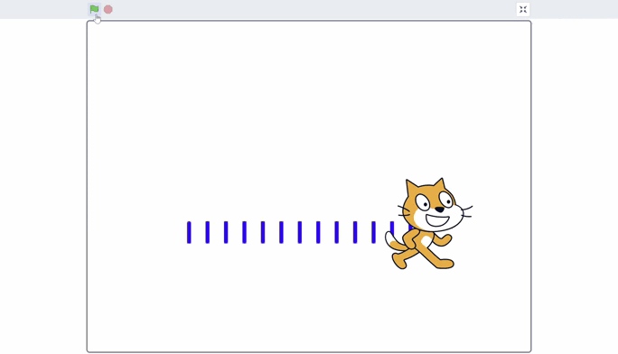
Medium challenges
34. Drawing Vertical Lines
The sprite asks the user to enter a number N, then uses the pen to draw N vertical lines arranged sequentially on the stage.

Slide 79
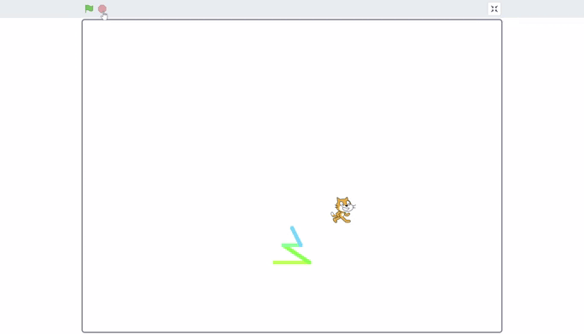
Medium challenges
35. Drawing a Christmas Tree by Number N
The sprite asks the user to enter a number N — the height of the tree. The number N determines the number of horizontal lines that make up the tree. After entering the value, the sprite uses the pen to draw a tree with N horizontal lines, each new line shorter than the previous one and in a new color, as shown in the example.

Slide 80
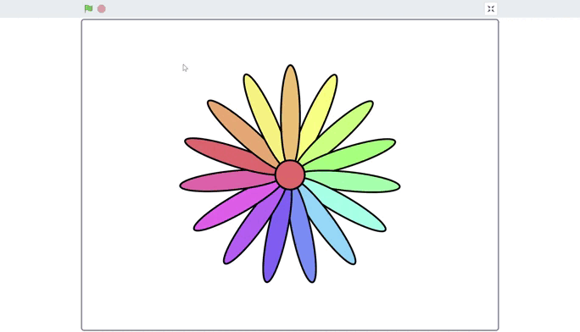
Medium challenges
36. Drawing a Flower
The sprite asks the user to enter a number N, after which it draws a flower with N petals. Each new petal has a different color.

Slide 81
Medium challenges
37. Password Program
Create a program in which the sprite asks the user to enter a password. If the entered password does not match the stored password, the sprite reports that the password is incorrect and asks to try again. The program continues until the user enters the correct password.

Slide 82
Medium challenges
38. Determining a Cat’s Age
Write a program in which a cat sprite asks the user to enter the cat’s age. After entering, the sprite determines the age category:
Less than 1 year → “Kitten”
1 to 3 years → “Young cat”
4 to 6 years → “Adult cat”
Older than 7 years → “Mature cat”

Slide 83
Medium challenges
39. The sprite asks the user to enter the current hour (a number from 0 to 23).
After entering, the sprite determines:
5–11 → “It’s morning!”
12–16 → “It’s daytime!”
17–20 → “It’s evening!”
21–4 → “It’s night!”
The time-of-day message is accompanied by a background change. If it’s night, the background changes to night with the moon. If an invalid number is entered, the sprite warns the user and asks to enter the time again.

Slide 84
Medium challenges
40. Rate the Weather” Program
The sprite asks the user to enter the air temperature. After entering, the sprite determines:
Less than 0 → “Very cold!”
0–10 → “Chilly!”
11–20 → “Warm!”
Above 20 → “Hot!”
The weather determination is accompanied by changes to the sprite’s clothing: if it’s cold, the sprite wears a jacket; if it’s hot, the sprite wears shorts, etc. If the value is not a number or is too large, the sprite asks the user to enter it again.

Slide 85
Hard challenges – 40

Slide 86
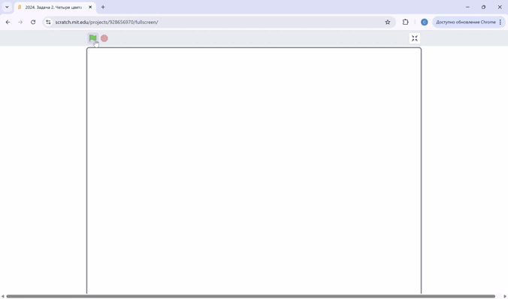
Hard challenges
1. Looking at the provided GIF animation, write a program in which the “Ball” sprite moves across the stage exactly like in the example and changes its color depending on which area of the stage it is in.

Slide 87
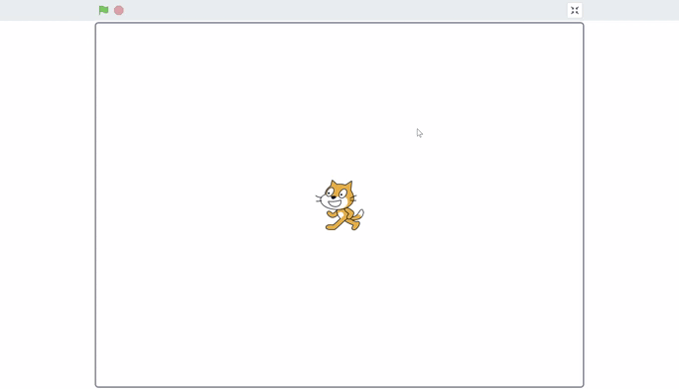
Hard challenges
2. The sprite asks for a number N, after which it draws N consecutive zigzags using the pen. At the end, it draws a line to turn the zigzags into triangles. Example:

Slide 88
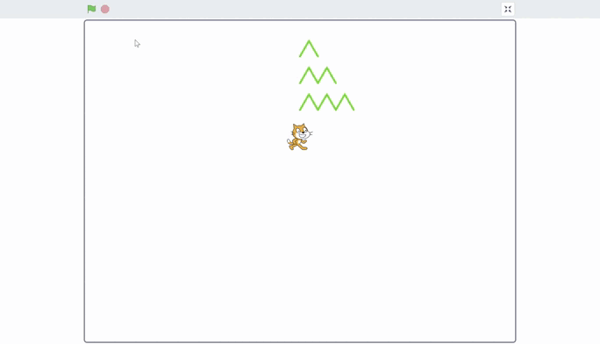
Hard challenges
3. The cat asks for a number N, then begins drawing zigzags with a height of N, as shown in the GIF animation.

Slide 89
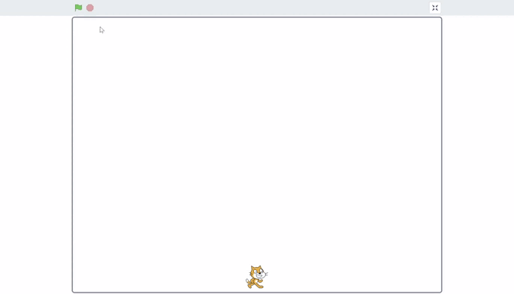
Hard challenges
4. The sprite asks for a number N, then begins drawing a Christmas tree of height N.

Slide 90
Hard challenges
5. Coin Collection. On the stage, 10 orange coins and 10 blue coins are randomly placed. The sprite is controlled using the arrow keys. Touching an orange coin increases the “Coins” variable by 1, while touching a blue coin decreases it by 1.

Slide 91
Hard challenges
6. Create a two-player ping-pong game. The paddle sprites are controlled using keyboard keys.

Slide 92
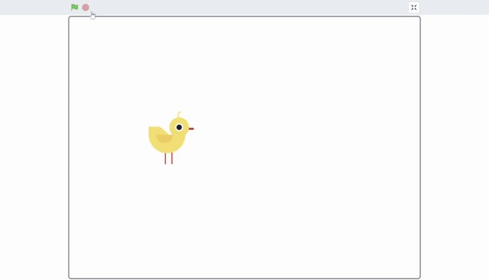
Hard challenges
7. Create the given animation. The sprite moves along a pentagon path, leaving its clones at the vertices of the shape. Then the clones start rotating. The rotation ends when the fifth clone completes a full turn around itself.

Slide 93
Hard challenges
8. Create a game in which two sprites compete to navigate a maze. The first player controls their sprite with the arrow keys, and the second player uses the W, A, S, D keys. There is an apple in the center of the maze, and the winner is the player who reaches it first without touching the walls.

Slide 94
Hard challenges
9. Universal Unit Converter.
Write a program in which the sprite first asks the user to enter a number N in centimeters. Then the sprite asks which unit to convert to: millimeters, meters, or kilometers. After the selection, the program performs the calculation, and the sprite announces the result.
For example, if the user enters 123 cm and chooses to convert to millimeters, the sprite should say:
“123 cm = 1230 mm.”

Slide 95
Hard challenges
10. Math Quiz.
The sprite displays two random numbers and randomly selects an operation — addition or subtraction. The user must enter the correct answer. After entering it, the sprite checks the result: if correct, it confirms and awards one point; if incorrect, it reports an error, subtracts one point, and asks the user to try again until the correct answer is given.
The quiz continues until the user scores 5 correct answers.

Slide 96
Hard challenges
11. Mini School (Grades)
The sprite asks for the student’s name, then asks the user to enter grades for 4 subjects. After all grades are entered, the sprite calculates the average score and gives a comment: “excellent,” “good,” “satisfactory,” or “needs improvement.”
The program repeats for 2 students.

Slide 97
Hard challenges
12. Login and Password
Create a program where the sprite asks for a username and then a password. If the username and password match the predefined values, the sprite says “Welcome!” If not, it reports an error and asks the user to try again. The program continues until the correct login–password pair is entered.

Slide 98
Hard challenges
13. Multiplication Table Quiz
The sprite randomly selects two numbers from 1 to 9 and asks for their product.
If the user answers incorrectly, the sprite says: “Incorrect, try again!” and asks the same question again.
If correct, the sprite says: “Well done!” and adds 1 point. If the answer is wrong, 1 point is subtracted.
The program continues until the player reaches 5 points.

Slide 99
Hard challenges
14. Simple Password Check
The sprite asks the user to create a password.
If the password is shorter than 5 characters, the sprite says the password is too simple and asks the user to try again.

Slide 100
Hard challenges
15. Secret Color
The sprite selects one color: red, green, or blue.
The user makes guesses.
Until the color is guessed correctly, the sprite says: “No, try again!”
Once guessed, the sprite changes its costume to that color.

Slide 101
Hard challenges
16. Reaction Speed Test
The sprite unexpectedly says: “PRESS!” after a random delay of 1–5 seconds.
The user must press any key.
The sprite measures reaction speed and displays the result on the screen.

Slide 102
Hard challenges
17. Mini-ATM
Create a program where the sprite works as a simple ATM.
1. The sprite first asks the user for a PIN code. If the PIN is incorrect, it reports an error and asks again until the correct PIN is entered.
2. After successful entry, the sprite shows a menu: “Deposit” or “Withdraw.”
3. The user chooses an action, enters an amount, and the sprite updates the balance:
- Deposit → increases the balance by the entered amount
- Withdraw → decreases the balance only if there are sufficient funds; otherwise, it reports insufficient funds
4. After each operation, the sprite shows the current balance and asks for the next action.
5. The program continues until the user exits, e.g., by entering the command “exit.”

Slide 103
Hard challenges
18. Mini-Restaurant (Food Ordering)
Create a program where the sprite works as a waiter. Logic:
1. When the green flag is clicked, the sprite greets the user.
2. Shows the menu:
-“Pizza — 20”
-“Burger — 15”
-“Tea — 5”
- “Exit”
3. The user enters a dish name.
4. If the dish is unavailable, the sprite reports an error and asks again.
5. If the dish is available, the sprite adds its price to the order total.
6. After each choice, the sprite shows the current order total.
7. The program continues until the user enters “Exit.”
8. At the end, the sprite reports the final total.

Slide 104
Hard challenges
19. Registration and Login System
Create a program simulating account registration.
Stage 1: Registration
1. The sprite asks the user to create a username.
2. The sprite asks the user to create a password.
3. Save both in variables.
Stage 2: Login
1. The sprite asks the user to log in.
2. The user enters a username. If incorrect, the attempt repeats.
3. Then the user enters a password. If incorrect, the attempt repeats.
4. Upon successful login, the sprite says: “Welcome!”
Optional: You can add a limit, e.g., only three login attempts.

Slide 105
Hard challenges
20. Mini-Shop with Cart
The user can add items to a cart.
1. Items and prices:
Apple — 3
Bread — 6
Milk — 10
2. The user enters commands: “apple,” “bread,” “milk,” “cart,” “exit.”
3. If an item is selected, its price is added to the total.
4. If the user types “cart,” the sprite shows the total amount.
5. The program continues until the user enters “exit.”

