Slide 1


Slide 2
BRAINIACS OLYMPIAD 2026
CODING SAMPLE CHALLENGES
(GRADES 5–7)
Easy challenges – 40
Medium challenges – 40
Hard challenges – 20

Slide 3
Easy challenges – 40

Slide 4
Easy challenges
1. The sprite asks for a name and greets the user by name.

Slide 5
Easy challenges
2. The sprite asks for the age and tells how many years it will take for the user to be 100.

Slide 6
Easy challenges
3. The sprite asks for two numbers and displays their sum.

Slide 7
Easy challenges
4. The sprite asks for a number N and says the numbers from 1 to N. Numbers can be negative or positive.

Slide 8
Easy challenges
5. The sprite asks for a number N and says any word N times.

Slide 9
Easy challenges
6. The sprite displays its X and Y coordinates on the screen.

Slide 10
Easy challenges
7. The sprite follows the mouse pointer.

Slide 11
Easy challenges
8. The sprite draws a triangle, then a square, a pentagon, and a circle using pen blocks. The sizes of the shapes should be the same.

Slide 12
Easy challenges
9. When the spacebar is pressed, the sprite changes its costume. When the arrow keys (up, down, left and right) are pressed, the sprite moves in the corresponding direction.

Slide 13
Easy challenges
10. The sprite asks for a number and says whether it is greater than 10 or not.

Slide 14
Easy challenges
11. The sprite changes color when clicked with the mouse. One click changes it to the next color. The sprite has 7 colors – red, orange, yellow, green, light blue, dark blue, purple.

Slide 15
Easy challenges
12. When the sprite is clicked with the mouse pointer, it slowly hides and shows in a random position after 2 seconds.

Slide 16
Easy challenges
13. The sprite asks for a number from 1 to 10, after which its size changes to 10 times the entered number. If 10 is entered, the sprite’s size is 100%.

Slide 17
Easy challenges
14. The sprite asks for a number N and then outputs all odd numbers from 1 to N. Each number is displayed for 0.2 seconds.

Slide 18
Easy challenges
15. The sprite asks for a number from 1 to 5 and displays the multiplication table for that number on the screen.

Slide 19
Easy challenges
16. The sprite asks for a number and then says whether the number is positive or negative. If the number is positive, the sprite turns red; if negative, it turns blue; if the number is 0, the sprite does not change color.

Slide 20
Easy challenges
17. The sprite asks for two numbers and reports their difference.

Slide 21
Easy challenges
18. When the key “1” is pressed, the sprite becomes red; “2” – blue; “3” – green.

Slide 22
Easy challenges
19. The sprite asks for a number and says whether it is even or not.

Slide 23
Easy challenges
20. Create a “traffic light” animation. Red light – stop – the car stays still. Yellow light – wait – engine sound plays. Green light – go – the car passes the traffic light.

Slide 24
Easy challenges
21. The sprite changes size every 0.1 seconds, creating a breathing effect.

Slide 25
Easy challenges
22. The sprite grows when the mouse pointer is near it and shrinks when the mouse is moved away.

Slide 26
Easy challenges
23. Four colored squares (red, green, yellow, blue) are placed in the corners of the stage. When the sprite touches a color, it plays a sound (says the color) and changes its color to the one it touched. The sprite moves across the stage using arrow keys.

Slide 27
Easy challenges
24. Counter: pressing the up arrow increases the counter by 1; pressing the down arrow decreases the counter by 1. One click changes the value by 1.

Slide 28
Easy challenges
25. The sprite asks for a number and says whether it is divisible by 3.

Slide 29
Easy challenges
26. Write a program for a ball. When the green flag is pressed, the ball bounces off the walls.

Slide 30
Easy challenges
27. Write a program for a basketball. The sprite asks for a number N, and the basketball jumps N times.

Slide 31
Easy challenges
28. The sprite asks the user, “How are you feeling today?” and repeats the answer.

Slide 32
Easy challenges
29. Using three standard arrow sprites (“Arrow1”), place them in a line so they don’t touch when rotated. Write a program so that after pressing the flag – the left arrow makes one full turn, the middle arrow makes two full turns, and the right arrow makes three full turns. All three arrows should finish moving at the same time.

Slide 33
Easy challenges
30. The sprite draws a line of length N steps.

Slide 34
Easy challenges
31. The sprite draws a square with side N.

Slide 35
Easy challenges
32. The sprite displays a random compliment from 5 options.

Slide 36
Easy challenges
33. The sprite reports the current “weather” (randomly chosen from 4 options).

Slide 37
Easy challenges
34. The sprite asks for a number and says: “That’s a lot!” or “That’s a little!”. A number is considered large if it is greater than 50.

Slide 38
Easy challenges
35. The sprite repeats any entered word backward.

Slide 39
Easy challenges
36. When the green flag is clicked, the sprite asks the user for their favorite color
- If the user enters one of the 7 available colors, the sprite changes its color accordingly.
- If an unknown color is entered, the sprite says: “I only know 7 colors!”

Slide 40
Easy challenges
37. The sprite asks for a number and says the square of that number.

Slide 41
Easy challenges
38. The sprite smoothly disappears and reappears when the spacebar is pressed.

Slide 42
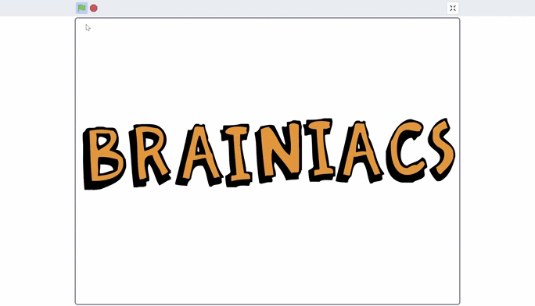
Easy challenges
39. Disappearing letters. On the stage, there is the word BRAINIACS. After the program starts, when the letter B is clicked, it shrinks and hides. When the program is restarted, the letter returns to its place. Come up with a way for the remaining letters to disappear. Each letter disappears in its own unique way.

Slide 43
Easy challenges
40. The sprite moves across the screen endlessly. When it touches the edge, it bounces back, says “Ouch,” and keeps moving. Each time it is clicked, it rotates 15 degrees to right.

Slide 44
Medium challenges – 40

Slide 45
Medium challenges
1. The sprite asks for two numbers - a and b, then says which number is greater, which is smaller, or they are equal.

Slide 46
Medium challenges
2. Write a program – the cat asks for the number of corners of a shape, then starts drawing that shape. Solve the task without using conditions.

Slide 47
Medium challenges
3. Create a falling snowflake animation: the clone moves downward and disappears.

Slide 48
Medium challenges
4. Implement the game “Catch Me”: the sprite runs away from the mouse. If the mouse catches the sprite, the game ends, and the program displays the total time the player took to catch the sprite.

Slide 49
Medium challenges
5. Create a “dice throw simulator.”
When the dice sprite is clicked, it should show a random face – a number from 1 to 6.
Each face should display the corresponding number of dots.

Slide 50
Medium challenges
6. Make a countdown timer with a step of 0.5 seconds. The user enters a starting number N.

Slide 51
Medium challenges
7. The sprite walks in a figure-eight pattern, changing costumes.

Slide 52
Medium challenges
8. Create a program – a calculator with two operations (addition and subtraction). The sprite asks for two numbers: a and b, and an operation “+” or “-”, then displays the result.

Slide 53
Medium challenges
9. Create a “Catch the Apple” game with a score counter.

Slide 54
Medium challenges
10. The sprite follows the mouse pointer. When the spacebar is pressed, the sprite speeds up; when the L key is pressed, it slows down; if no key is pressed, the sprite moves at normal speed (10 steps).

Slide 55
Medium challenges
11. Create a simple quiz with 5 questions about space.
The sprite asks each question in sequence, waits for the user’s answer, and tells whether the answer is correct or not.
At the end, it displays the total number of correct answers.

Slide 56
Medium challenges
12. Implement the game “Guess the Number.”
The sprite chooses a random number from 1 to 100.
The user enters guesses, and the sprite tells whether the guess is higher or lower than the chosen number. The game continues until the user guesses correctly, after which the sprite displays a victory message.

Slide 57
Medium challenges
13. Create a sprite training animation.
The sprite asks for a number N, then performs a squatting animation N times (by changing costumes).

Slide 58
Medium challenges
14. Implement sprite control using the arrow keys.
When the arrow keys are pressed, the sprite should move in the corresponding direction but cannot pass through black lines (obstacles) on the stage.

Slide 59
Medium challenges
15. Draw a spinning spiral on the stage using the pen. When the green flag is clicked (or the sprite is clicked), the sprite should put the pen down and draw a spiral that gradually “unwinds,” with the distance between the loops increasing as it moves away from the center.

Slide 60
Medium challenges
16. Implement a mechanical clock animation.
The stage should have three sprites: second hand, minute hand, and hour hand.
- The second hand completes one full rotation (360°) in 60 seconds.
- The minute hand completes one full rotation in 60 minutes.
- The hour hand rotates 30° every hour.

Slide 61
Medium challenges
17. The program outputs the largest number of three entered numbers.

Slide 62
Medium challenges
18. The program outputs the smallest number of three entered numbers.

Slide 63
Medium challenges
19. The program outputs the largest number of five entered numbers.

Slide 64
Medium challenges
20. The program outputs the smallest number of five entered numbers.

Slide 65
Medium challenges
21. Create a program that calculates the sum of numbers from 1 to N.
Example: if N = 10, the sum of all numbers from 1 to 10 = 55.

Slide 66
Medium challenges
22. Create a program that calculates the difference of numbers from N to 1.
Example: if N = 10, the difference of all numbers from 10 to 1 = -35.

Slide 67
Medium challenges
23. Implement an animation of a bouncing ball with decreasing jump height.

Slide 68
Medium challenges
24. Write a program – the sprite asks for a number and determines whether it is positive or negative.
- If the number is positive, the sprite turns red; if negative, the sprite turns blue.

Slide 69
Medium challenges
25. Math Quiz
The sprite chooses two random numbers a and b from 0 to 100. The sprite asks: “What is the sum of a + b?” and waits for the user’s answer. If the answer is correct, applause sound plays; otherwise, an “ouch” sound plays.

Slide 70
Medium challenges
26. Math Quiz
The sprite chooses two random numbers a and b from 0 to 100. The sprite asks: “What is the difference a - b?” and waits for the user’s answer. If the answer is correct, applause sound plays; otherwise, an “ouch” sound plays.
The first number should always be greater than the second to avoid negative answers.

Slide 71
Medium challenges
27. The sprite asks the user for a number – the movement speed – and then moves at that speed until it touches the edge of the stage. Upon reaching the edge, the sprite returns to the center of the stage and asks for a speed again for the next movement.

Slide 72
Medium challenges
28. The sprite follows the mouse pointer. If the spacebar is pressed, the sprite leaves a trail behind it; when the key is not pressed, no trail is left.

Slide 73
Medium challenges
29. The sprite asks for a number (no more than 9999) and reports how many digits are in that number.
Example: if the number 99 is entered, the sprite says the number has 2 digits.

Slide 74
Medium challenges
30. Create a “Tank” game where the tank is controlled using the arrow keys for movement, and shooting is performed by pressing the spacebar.

Slide 75
Medium challenges
31. Using the pen block, the sprite draws a flower made of repeating petals.

Slide 76
Medium challenges
32. The sprite moves across the stage, accelerating with each step.

Slide 77
Medium challenges
33. The sprite asks for a number N and draws an N-sided polygon, changing the pen color on each side of the shape.

Slide 78
Medium challenges
34. Create a heartbeat animation using costumes and sounds.

Slide 79
Medium challenges
35. Create a dialogue animation between two sprites. The dialogue should consist of 5 questions and answers.

Slide 80
Medium challenges
36. Robot vacuum.
Trash (clones) is scattered on the stage. If the sprite touches the trash, it disappears. The robot vacuum follows the mouse pointer.

Slide 81

Medium challenges
37. Add a sprite – a white square with a black outline. When the green flag is clicked, the sprite moves across the stage leaving its clones behind. Recreate the drawing shown below.

Slide 82
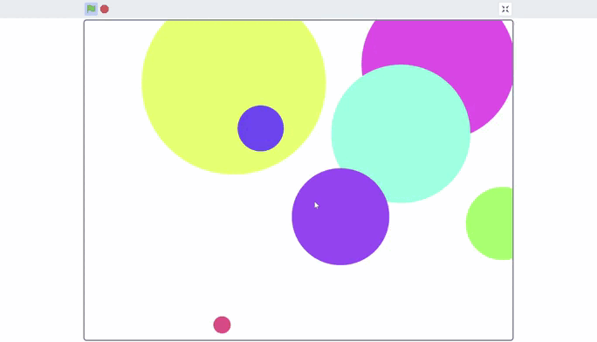
Medium challenges
38. Create an animation of growing bubbles as shown in the illustration below.

Slide 83

Medium challenges
39. Write a program – after the program starts, the sprite should draw the given shape using the pen.

Slide 84
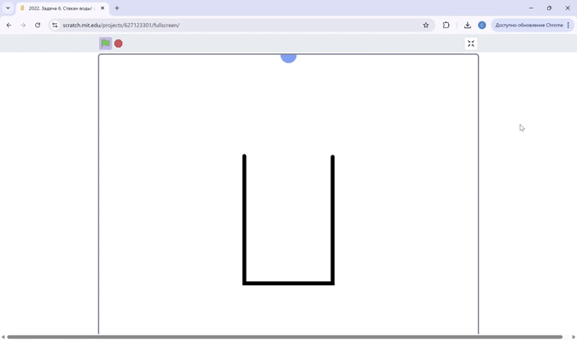
Medium challenges
40. Create an animation of a glass being filled with water as shown in the picture. The glass fills up as the number of water drops reaches 30.
When the glass is full, the program restarts.
Additionally, when the water drops touch the glass, it should play a corresponding sound.

Slide 85
Hard challenges – 40

Slide 86
Hard challenges
1. Create a “Maze” game with a wall touch sensor.

Slide 87
Hard challenges
2. Create a simulation of the solar system with orbits.

Slide 88
Hard challenges
3. Create a “Platformer” game.

Slide 89
Hard challenges
4. Create a drawing editor (pen, colors, clear).

Slide 90
Hard challenges
5. Create a “Flappy Bird” game.

Slide 91
Hard challenges
6. “Space Shooter” game: spaceship, meteors, lives.

Slide 92
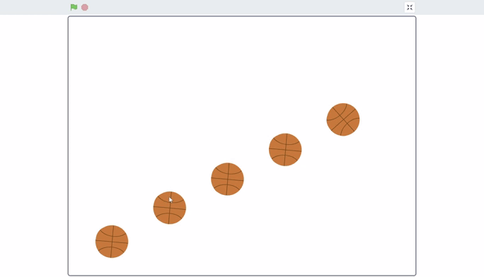
Hard challenges
7. Basketball
Using the basketball sprite “Basketball,” write a program that performs the given animation when the green flag is clicked.

Slide 93
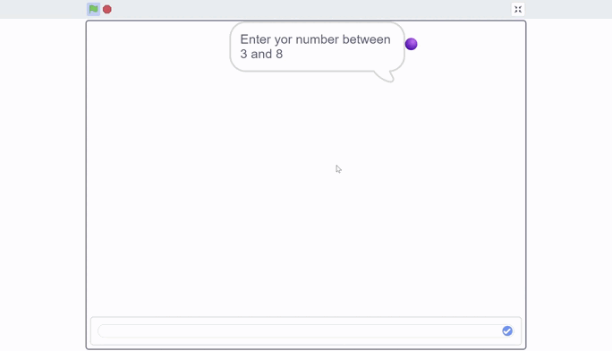
Hard challenges
8. Polygons made of balls
Using the sprite “Ball,” create a program that does the following:
When the green flag is clicked, ask the user to enter a number between 3 and 9.
Draw a polygon with the specified number of sides.
Place as many balls on each side as the number of sides.
Ensure all sides are equal in length and all angles are equal.
The polygon should fit entirely on the stage for any number from 3 to 8.
Solve the task without using conditions.

Slide 94
Hard challenges
9. Counter
When the up arrow key is pressed, the counter increases by 1; when the down arrow key is pressed, the counter decreases by 1. One click changes the value by 1.
If the number becomes greater than 10, the count restarts from 0.
If the number becomes less than 0, the count also restarts from 0.

Slide 95
Hard challenges
10. Sprite movement with colored tracks
Write a program to control a sprite using the arrow keys.
The stage contains colored tracks – red and green.
When the sprite touches red lines, its speed is decreases by 2 times.
When it touches green lines, its speed is increased by 2 times.
On parts of the stage without color, the speed is 10.

Slide 96
Hard challenges
11. Laser duel
Two players control sprites A and B.
Each player can shoot lasers (clones).
When a laser hits the opponent, their life decreases by 1.
The first player to score 5 hits wins the game.

Slide 97
Hard challenges
12. Maze with Teleports
The stage contains 5 teleports of different colors.
If the player touches a green teleport, they are transported to the green point, and the same applies for the other colors.

Slide 98
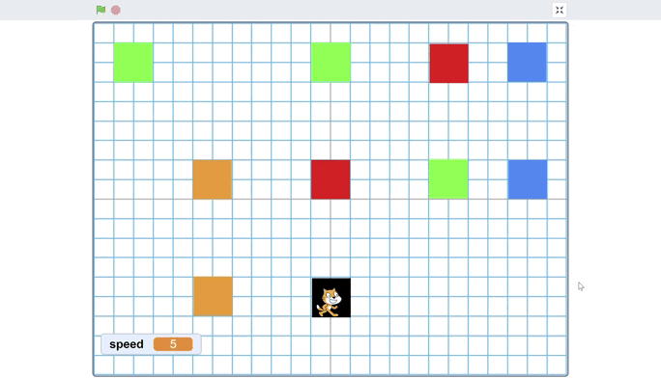
Hard challenges
13. Sprite Movement with Color Markers
The sprite moves on the stage and reacts to colored squares (markers):
Green square: speed increases by 5
Red square: speed decreases by 5
Blue square: sprite turns 90° clockwise
Orange square: sprite turns 90° counterclockwise
Black square: sprite stops completely
Example of the program:

Slide 99
Hard challenges
14. Star Catcher
Stars fall from the top (clones).
The player moves left and right.
If a star is caught → +1 point
If a star is missed → −1 point
The game ends if the score reaches −5.
The falling speed increases over time.

Slide 100
Hard challenges
15. Teleporting Cube
Every 3 seconds, the cube disappears and teleports to a random location.
If the player touches it before it teleports → +1 point
The player is controlled using the arrow keys.
The game ends when the player reaches 5 points.

Slide 101
Hard challenges
16. Moon and Earth Simulation
Create a simulation of the Moon orbiting the Earth.
Clicking on the Moon displays 5 interesting facts about the Moon.
Clicking on the Earth displays 5 interesting facts about the Earth.

Slide 102
Hard challenges
17. Maze Game with Three Levels
Create a maze game with three levels.
After completing the first maze, the next level starts with a new maze design and guards.
Each new level is harder, and the number of guards increases.

Slide 103
Hard challenges
18. Maze Game with Three Levels
Create a maze game with three levels.
After completing the first maze, the next level starts with a new maze design and guards.
Each new level is harder, and the number of guards increases.

Slide 104
Hard challenges
19. Google Dino Game
Create a game similar to the Google Dino game.

Slide 105
Hard challenges
20. Tank vs. Zombies (Two Players)
Player 1 controls a tank using arrow keys.
Player 2 controls a tank using WSAD keys.
Tanks can also shoot zombies.

